Slide 1


Lecture 5 Lists & Linked Lists
DATA STRUCTURE
AND ALGORITHMS
(CS 201)
5
Fall (2025-2026)

Slide 2
Course Learning Objectives
Implement and manipulate linear data structures such as arrays and linked lists, performing fundamental operations including insertion, deletion, and traversal.
Apply and implement special linear data structures such as stacks and queues, utilizing their core operations (push, pop, enqueue, and dequeue).
Design and implement basic sorting algorithms to organize data efficiently.
Apply searching algorithms, including sequential search, binary search, and hashing techniques.
Implement and manipulate non-linear data structures, particularly binary trees and binary search trees, performing key operations such as insertion, deletion, and traversal.
Utilize graph data structures and apply fundamental graph algorithms for problem-solving.
Demonstrate effective teamwork skills by collaborating within groups to develop algorithmic solutions.

Slide 3
Agenda
Classification of Data Structures
Abstract Data Types (ADT)
List ADT
  Array based implementation
  Linked list based implementation
1-3
Notes:
3

Slide 4
Classification of Data Structure
Data structure are normally divided into two main categories:
  Primitive
  Non-Primitive
Data Types
Primitive
Non-Primitive
Integer
Float
Character
Pointer
Integer
Float
Float
Notes:
A primitive data type is generally a basic structure that is usually built into the language, such as an integer, a float.
<number>

Slide 5
Classification of Data Structure
Non-Primitive
Linear List
Non-Linear List
Array
Queue
Graph
Trees
Link List
Stack
Notes:
Non Primitive DS
more sophisticated data types.
derived from the primitive data structures.
built out of primitive data structures linked together in meaningful ways
emphasize on structuring of a group of data items.
<number>

Slide 6
Abstract Data Types (ADTs)
ADT is a type (or class) for objects whose behavior is defined by a set of values and a set of operations.
It defines what the data structure can do (its operations) and what kind of data it holds (its values)
The definition of ADT only mentions what operations are to be performed but not how these operations will be implemented.
ABSTRACTION: it gives an implementation independent view.
Separate the implementation of Abstract Data Type providing ONLY the interface (BEHAVIOR) to the ADT.
Implementation of ADT is hidden from user
Notes:
It does not specify how data will be organized in memory and what algorithms will be used for implementing the operations
<number>

Slide 7
List ADT
A list contains elements of the same type arranged in sequential order.
Lists can be implemented using:
  Arrays Data Structure
  Linked Lists Data Structure
Operations that can be performed on Lists are :
  Print List
  Add new item (insert)
  Remove item (delete)
  Look at (get, Find) entry at given position on list.
  Replace (set) entry at given position on list.
  Is empty
Notes:
Things you make lists of
Addresses
Groceries
Class list
<number>

Slide 8
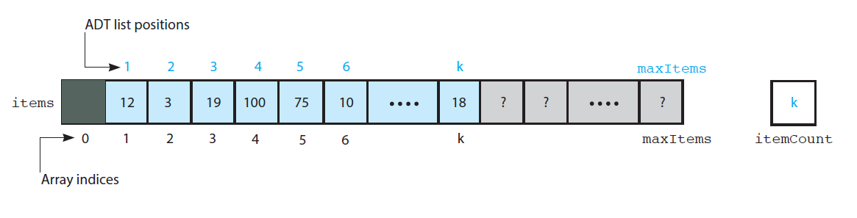
Array Based Implementation
Notes:
An array is a type of list. A list is an abstract data type that implies an ordered sequence of values. Another type of list is a linked list (double or single).
an array is always a list but a list is not always an array. :)
<number>

Slide 9
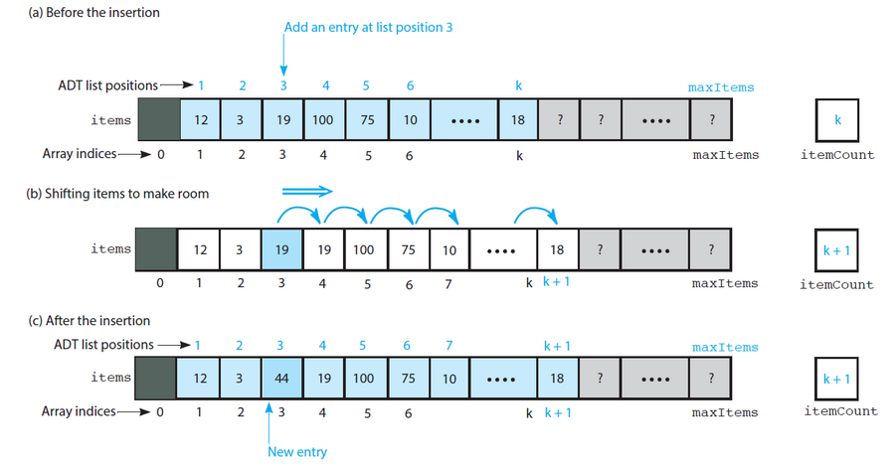
Array Based Implementation (Insert)
Shifting items for insertion
Notes:
Insert will take the position to insert the new element insert (3,44)
Steps to insert using array :
1- shift the array to make a room for the new element at the requested position
2- Insert the new element
Cost of this function is Linear O(n)
If we have multiple insertion it will take time
<number>

Slide 10
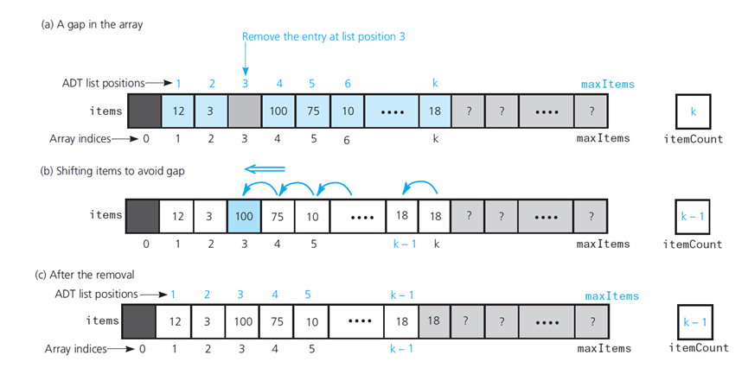
Array Based Implementation (Remove)
Shifting items for Deletion
Notes:
RemoveAt(3)
Steps to remove element using array :
1- Remove requested element
2- shift items to fill gap
Cost of this function is Linear O(n)
If we have multiple removal it will take time
<number>

Slide 11
Array based Implementation
Disadvantages:
  An estimate of the maximum size of the list is required, even if the array is dynamically allocated. Usually this requires a high overestimate, which wastes considerable space.
  Insertion and deletion are expensive. For example, inserting at position 0 requires first pushing the entire array down one spot to make room. (Array Shifting)
Because the running time for insertions and deletions is so slow and the list size must be known in advance, simple arrays are generally not good to implement lists.

Slide 12
Linked Lists
Another way to organize data items
  Place them within objects—usually called nodes
  Linked together into a “chain,” one after the other
The linked list consists of a series of structures, which are not necessarily adjacent in memory.
Each data item needs a pointer to lead to the next data item(next pointer).
head
A ₁
A 2
A 3
A 4
A 5
A linked list

Slide 13
Features of the linked list
The consecutive elements are connected by pointers.
The size of a linked list is not fixed.
The last node of the linked list points to null.
Memory is not wasted but extra memory is consumed as it also uses pointers to keep track of the next successive node.
The entry point of a linked list is known as the head.
head
A ₁
A 2
A 3
A 4
A 5
A linked list

Slide 14
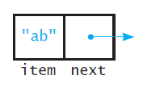
Linked Lists
Each data item needs a pointer to lead to the next data item(next pointer).
Data
A node is implemented as a structure OR a class
struct Node
{ int data;
Node* next;
};
class Node
{ int data;
Node* next;
public:
………..
// set and get functions };

Slide 15
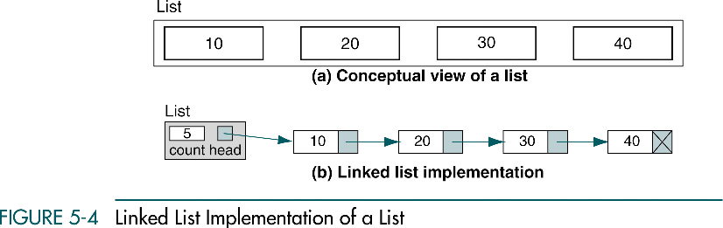
Linked List Implementation
class L_List
{
Node* head;
int itemCount;
};
Notes:
The head pointer is used to know where the first cell can be found.

Slide 16
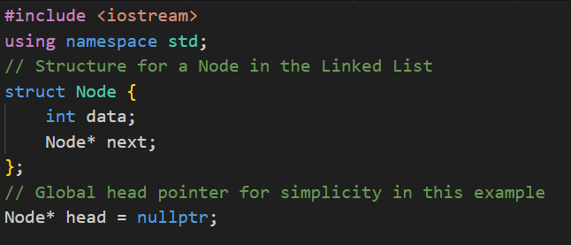
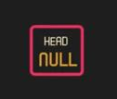
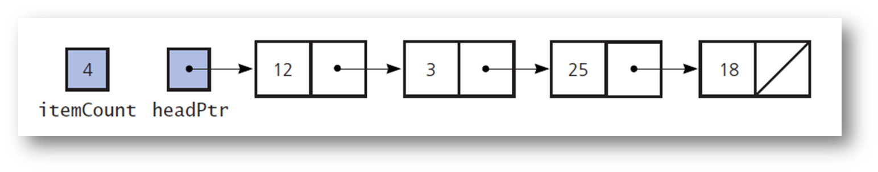
Linked List Implementation
1
1
head
A ₁
A 2
A 3
A 4
A 5
Notes:
The head pointer is used to know where the first cell can be found.

Slide 17
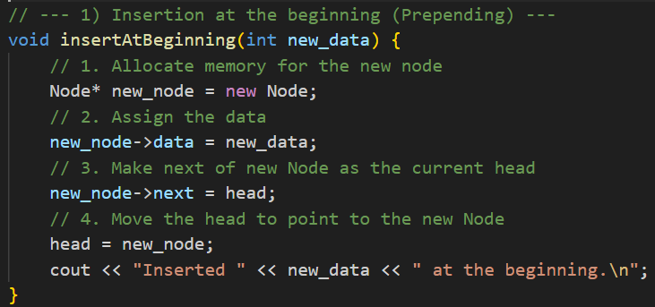
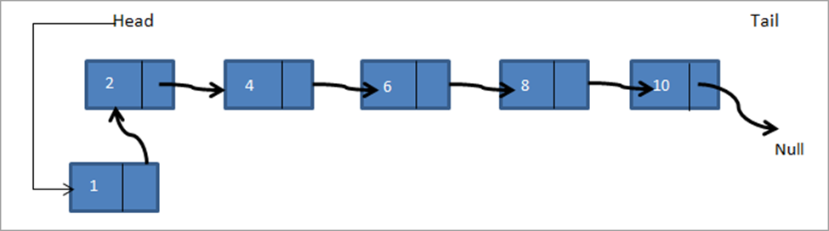
Linked List Implementation
(Insert a node)
2
There are three positions in the linked list where a data item can be added:
1) At the beginning of the linked list
2) After the given Node
3) At the end of the Linked List
1) At the beginning of the linked list
Notes:
The head pointer is used to know where the first cell can be found.

Slide 18
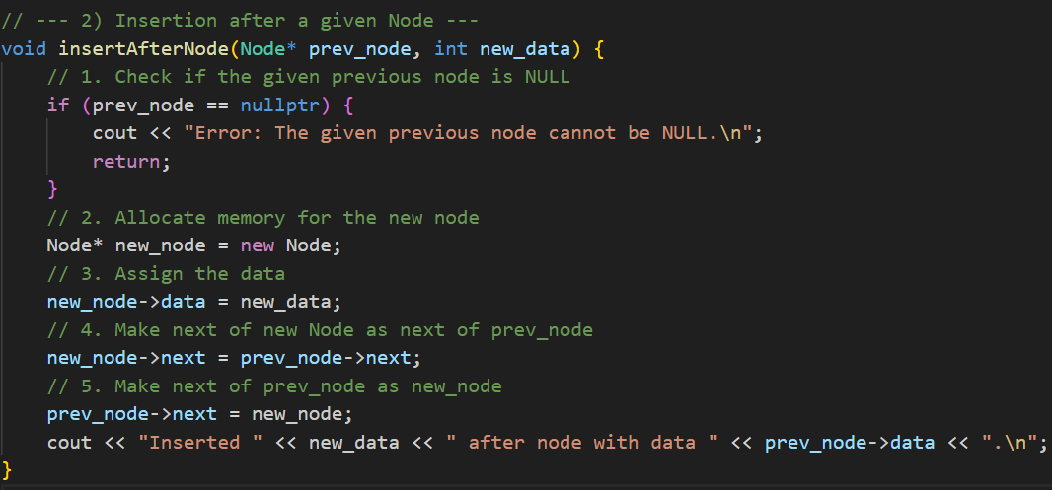
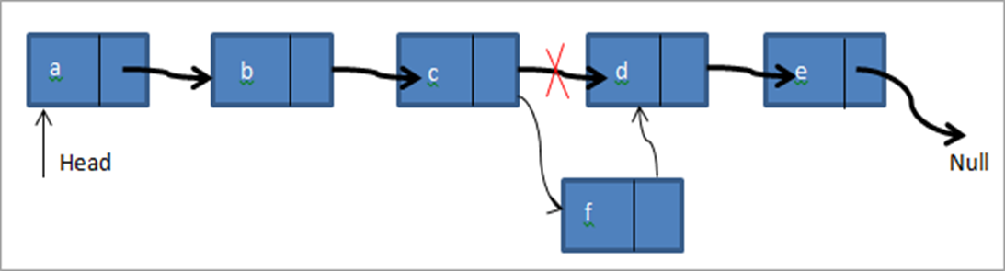
Linked List Implementation
(Insert a node)
2
2) After the given Node of the linked list
Notes:
The head pointer is used to know where the first cell can be found.

Slide 19
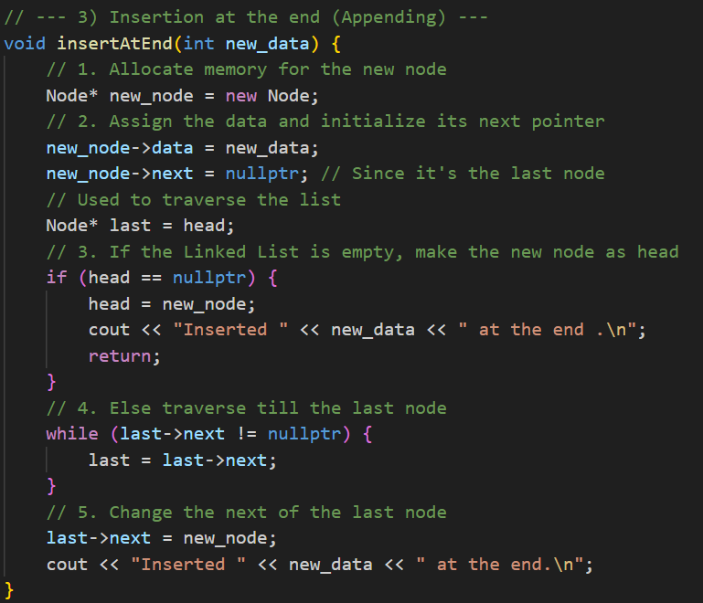
Linked List Implementation
(Insert a node)
2
3) At the end of the linked list
Notes:
The head pointer is used to know where the first cell can be found.

Slide 20
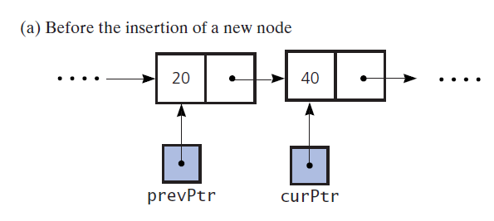
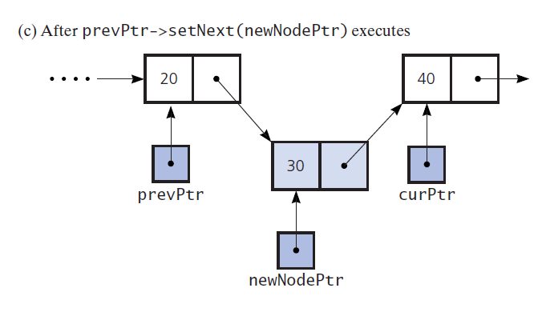
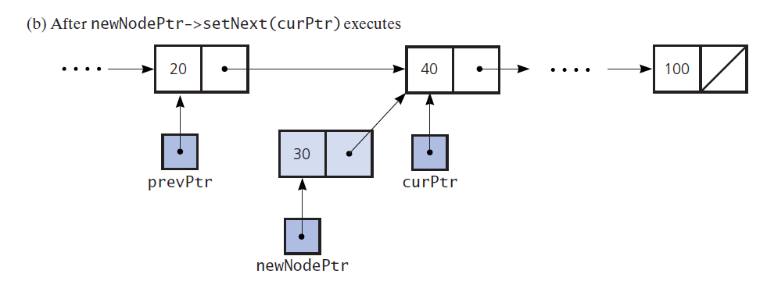
Linked List Implementation
(Insert a node)
2
Notes:
The head pointer is used to know where the first cell can be found.

Slide 21
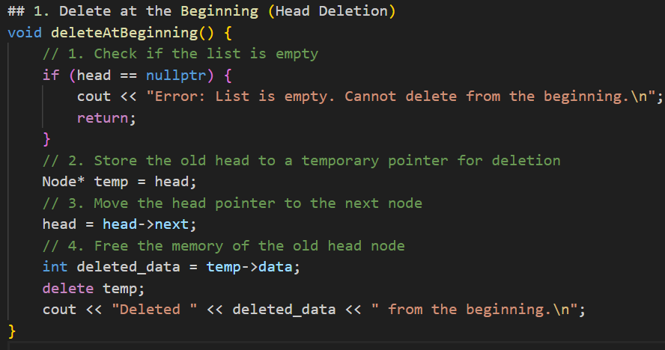
Linked List Implementation
(Delete a node)
3
1) At the beginning of the linked list
Notes:
The head pointer is used to know where the first cell can be found.

Slide 22
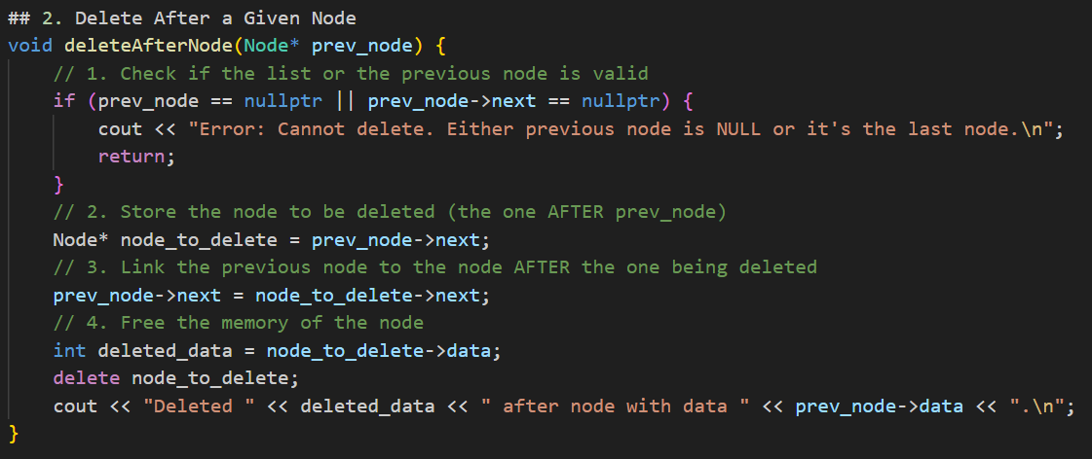
Linked List Implementation
(Delete a node)
3
2) After a given Node of the linked list
Notes:
The head pointer is used to know where the first cell can be found.

Slide 23
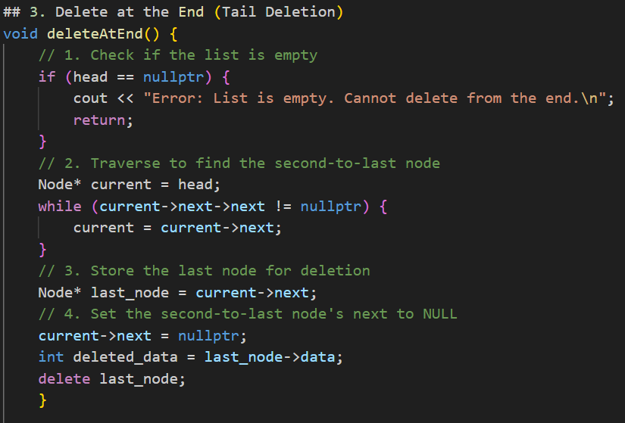
Linked List Implementation
(Delete a node)
3
3) At the end of the linked list
Notes:
The head pointer is used to know where the first cell can be found.

Slide 24
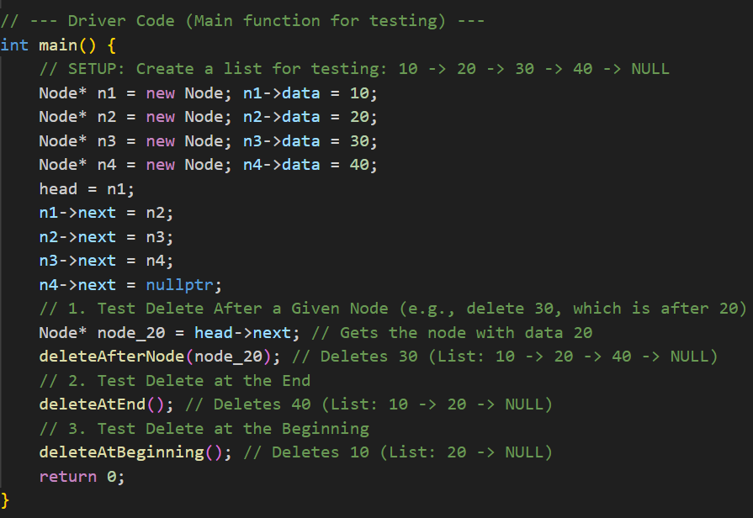
Linked List Implementation
(Main)
4
Notes:
The head pointer is used to know where the first cell can be found.

Slide 25
Doubly Linked Lists
Sometimes it is convenient to traverse lists backwards.
The solution is simple. Merely add an extra field to the data structure, containing a pointer to the previous cell. The cost of this is an extra link, which adds to the space requirement and also doubles the cost of insertions and deletions because there are more pointers to fix.
A₁
A₂
A₃
A₄
A₅
A doubly linked list
Notes:
How to implement doubly linked lists?
What about Circular Linked list?
Just add new pointer
<number>

Slide 26
Array vs. Linked List
Array | Linked List
Arrays are a linear data structure that store data items in contiguous locations. | Linked Lists are a linear data structure that does not store data items in contiguous memory locations.
Arrays have fixed size | Linked list size is dynamic
Insertion of new element is expensive | Insertion/deletion is easier
Random access is allowed | Random access not possible
Elements are at contiguous location | Elements have non-contiguous location
No extra space is required for the next pointer. | Extra memory space required for next pointer.

Slide 27
Applications of Linked Lists in real world
The list of songs in the music player are linked to the previous and next songs.
In a web browser, previous and next web page URLs are linked through the previous and next buttons.
In image viewer, the previous and next images are linked with the help of the previous and next buttons.

Slide 28



